Slide 1

Forecasting Spotify’s Customers 🎵
Pablo Prieri
Q3 2023

Slide 2
Analysis overview
Scope
Forecast the next 24 months of Net Customers and Intake metrics of 3 products in 3 different countries.
Explore dataset
Building intuition from the data
Generate forecast
Stating assumptions made.
Conclusion
And new paths of analysis

Slide 3
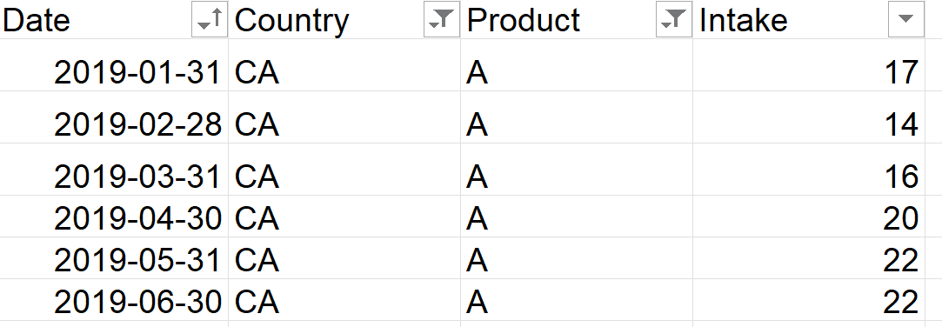
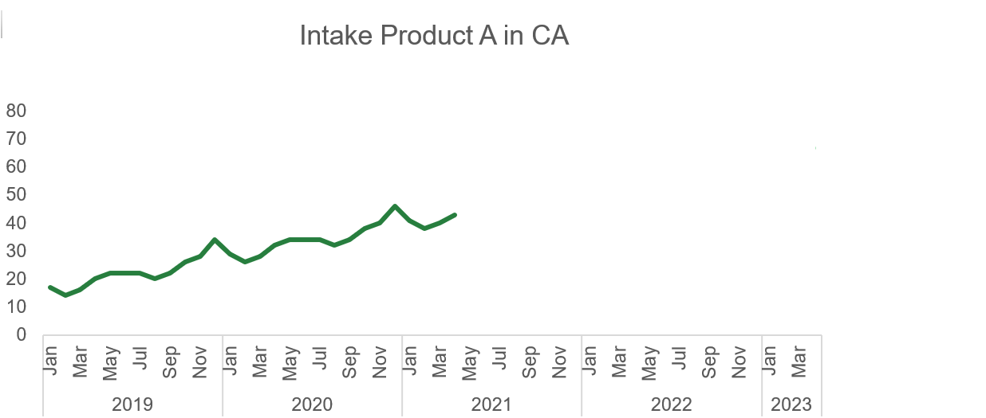
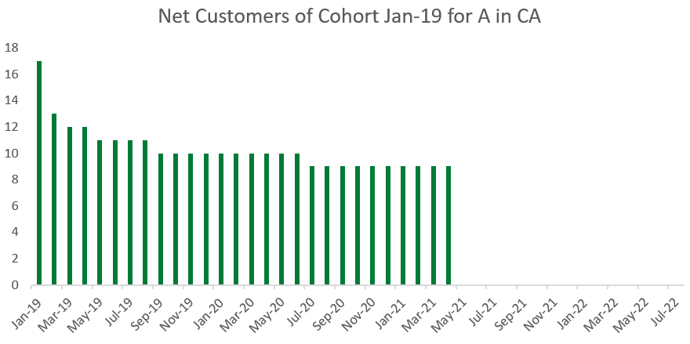
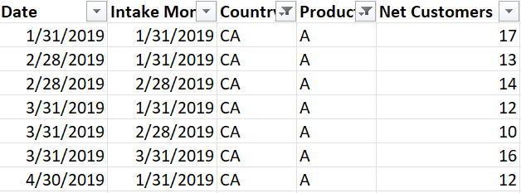
Datasets 📈
Dataset 1: historical numbers of customers for 3 products A, B and C across 3 markets CA, GB, US between Jan-2019 to April-2021
Dataset 2: for each of the group of new monthly customers in dataset 1 (acquisition cohorts), the number of retained customers over time

Slide 4
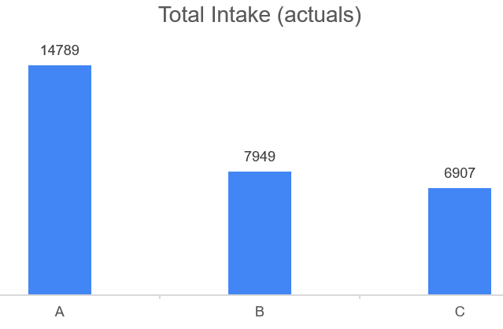
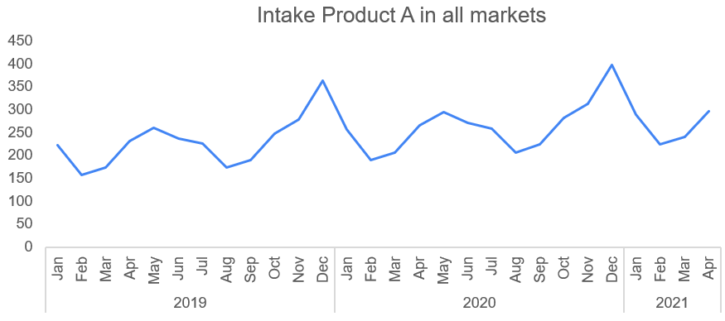
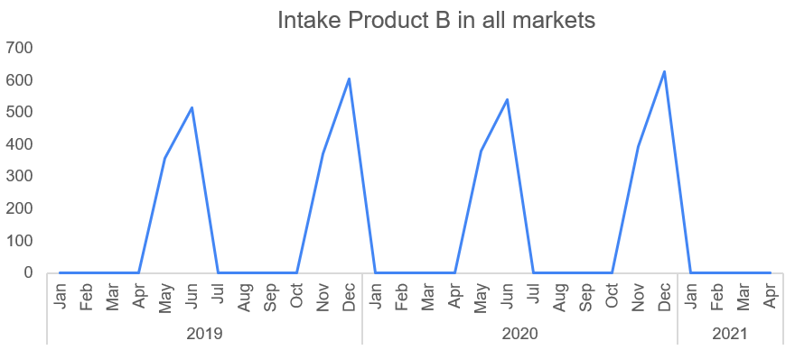
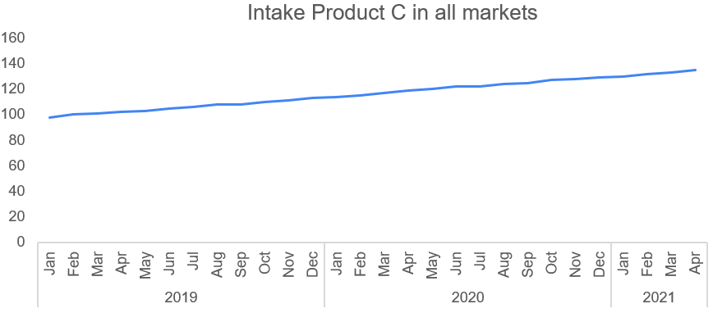
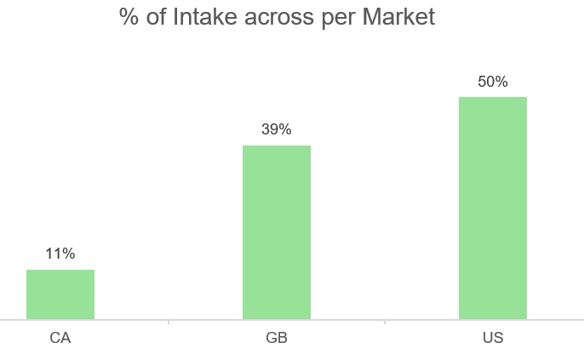
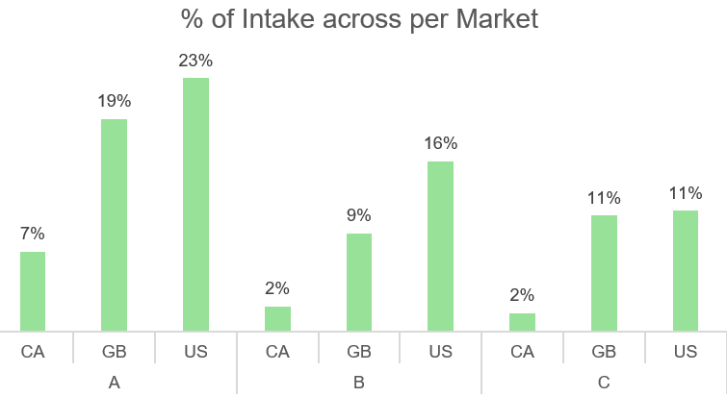
Meet the products💪
🌎 distribution

Slide 5
Part 1: forecast intake

Slide 6
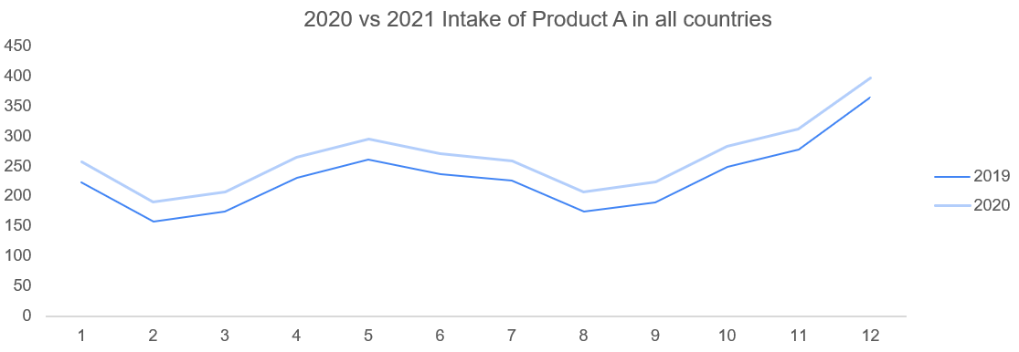
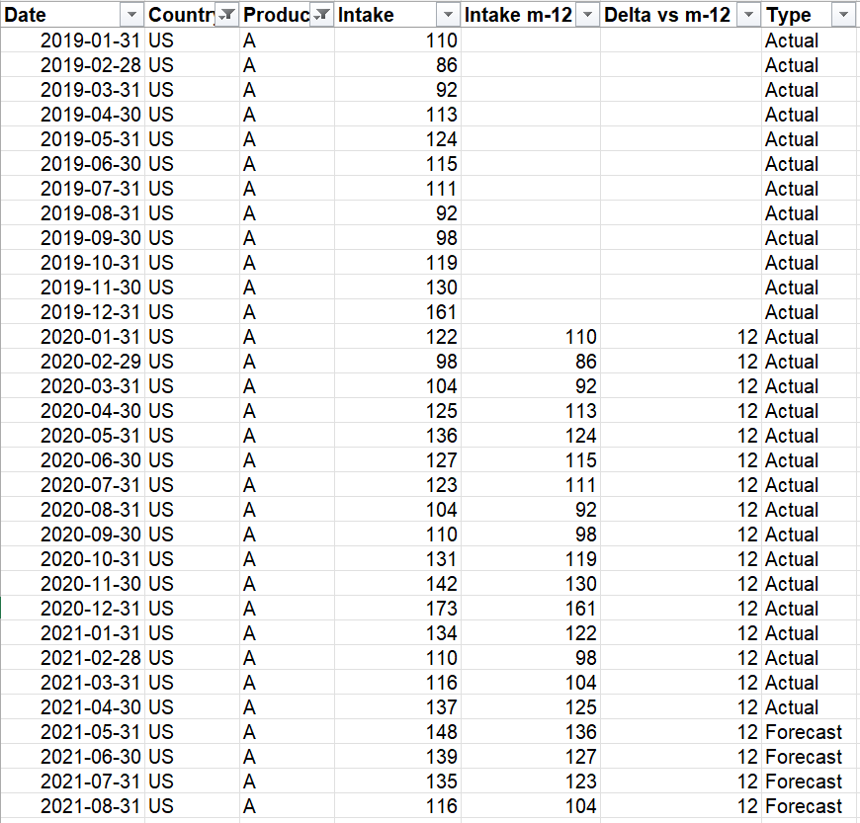
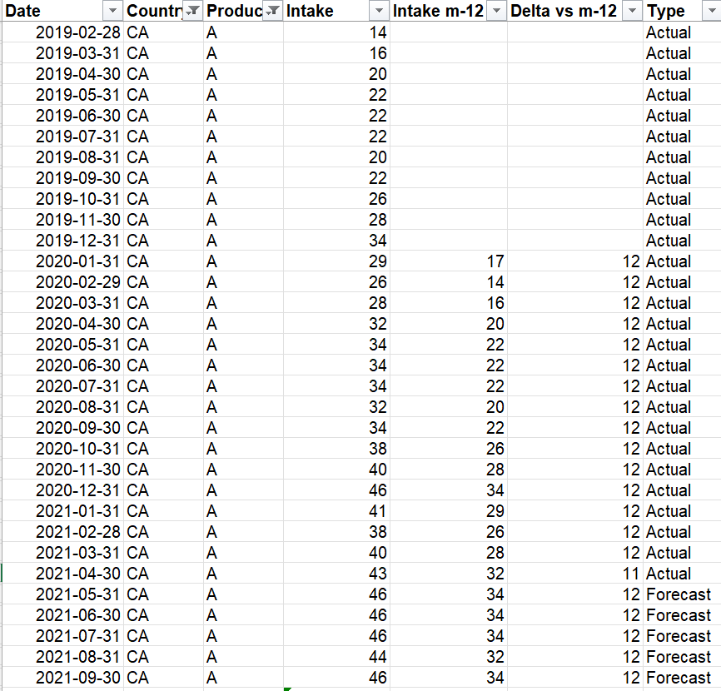
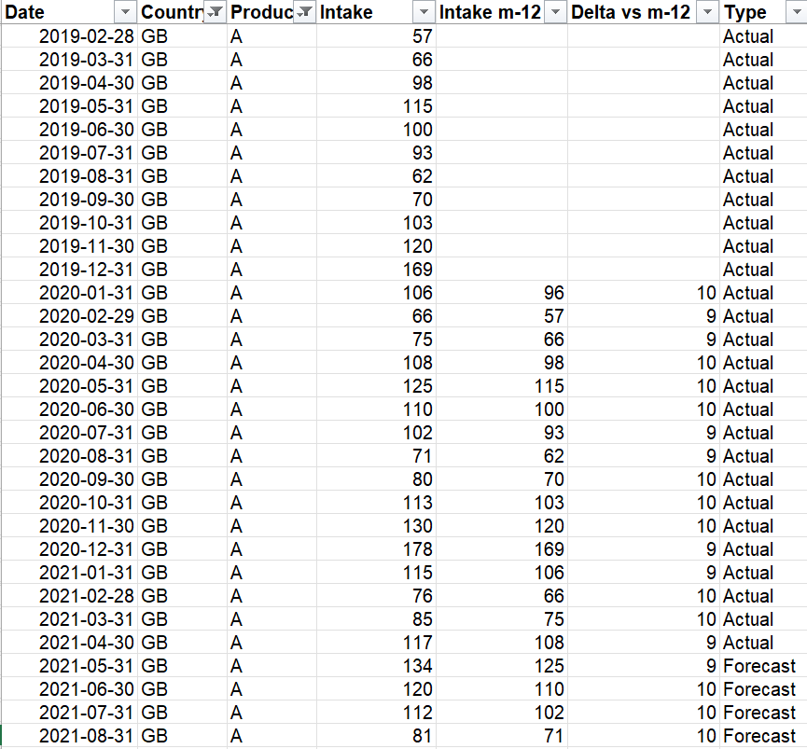

Exploring dataset 1 🔎
Product A: seasonal with additive trend
=> Seems to be a slow growing product in each market (maybe because of market saturation), with high seasonality, maybe this product are the new premium users?
Analysis and Forecast generation per country below*:
*main assumption: same pattern behavior in future as in past, more details in ‘submission_forecast_net_intake.xlsx’
Even though the numbers were calculated in Excel, we could have fitted a Linear Regression model like Y_{month} = slope * Y_{month – 12} + b, and obtain slope = 1 and b = delta above for all of them

Slide 7
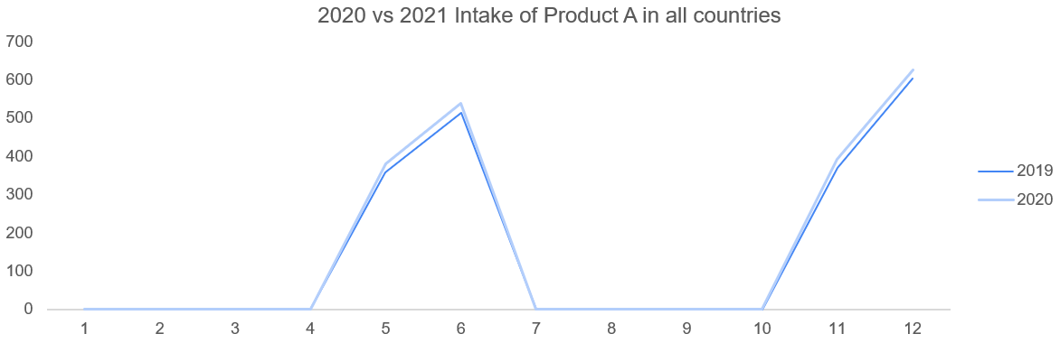
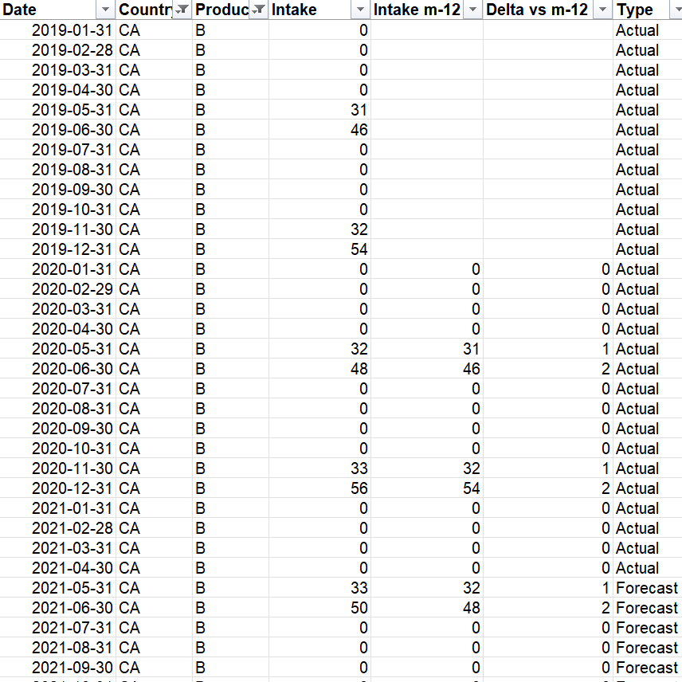
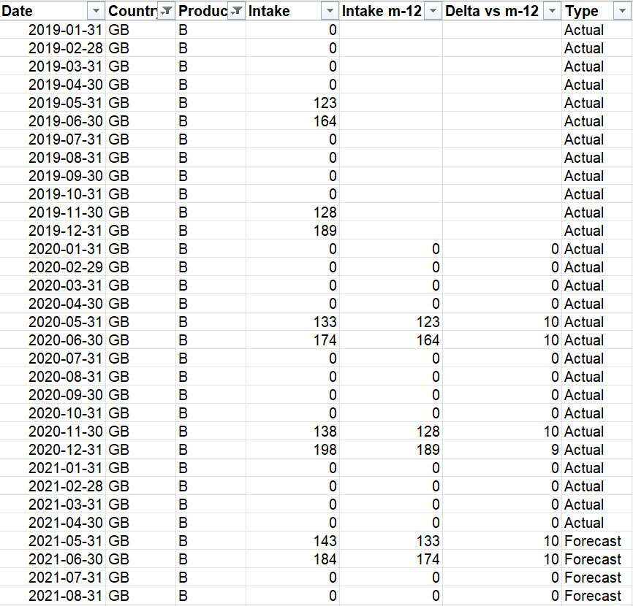
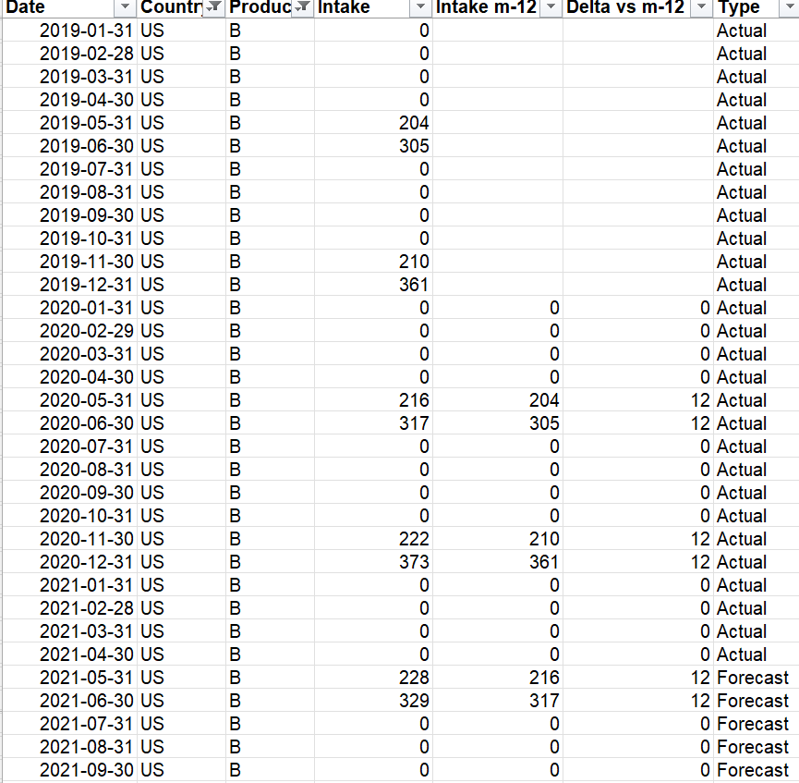
Exploring dataset 1 🔎
Product B: seasonal (intermittent) with additive trend.
=> given also that the retention rates are 100% in the first 3 months, this product seems to be a special Spotify premium offer right before the holidays (winter and summer), after which the retention rate starts dropping
Analysis and Forecast generation per country below*:
Even though the numbers were calculated in Excel, we could have fitted a Linear Regression model like Y_{month} = slope * Y_{month – 12} + b, and obtain slope = 1 and b = delta above for all of them
*main assumption: same pattern behavior in future as in past, more details in ‘submission_forecast_net_intake.xlsx’

Slide 8
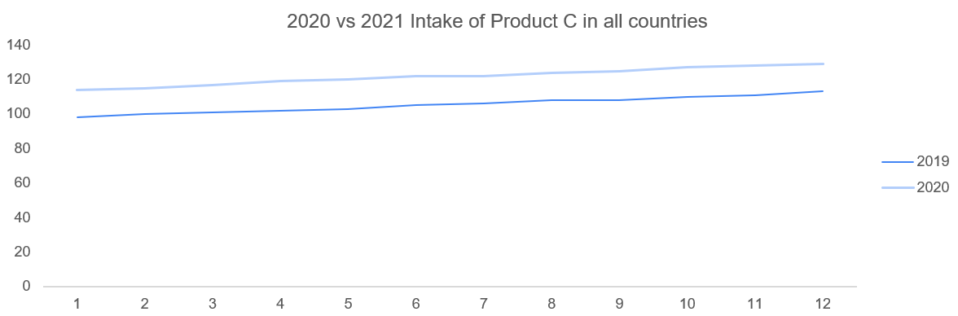
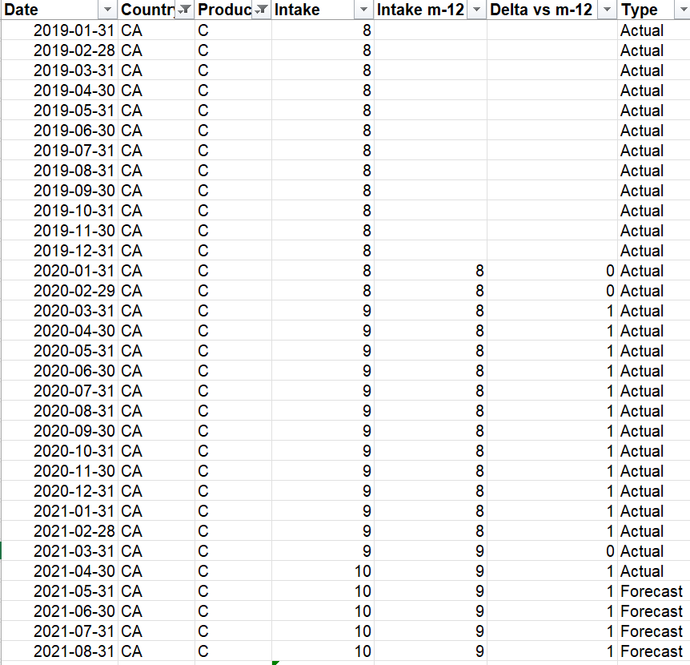
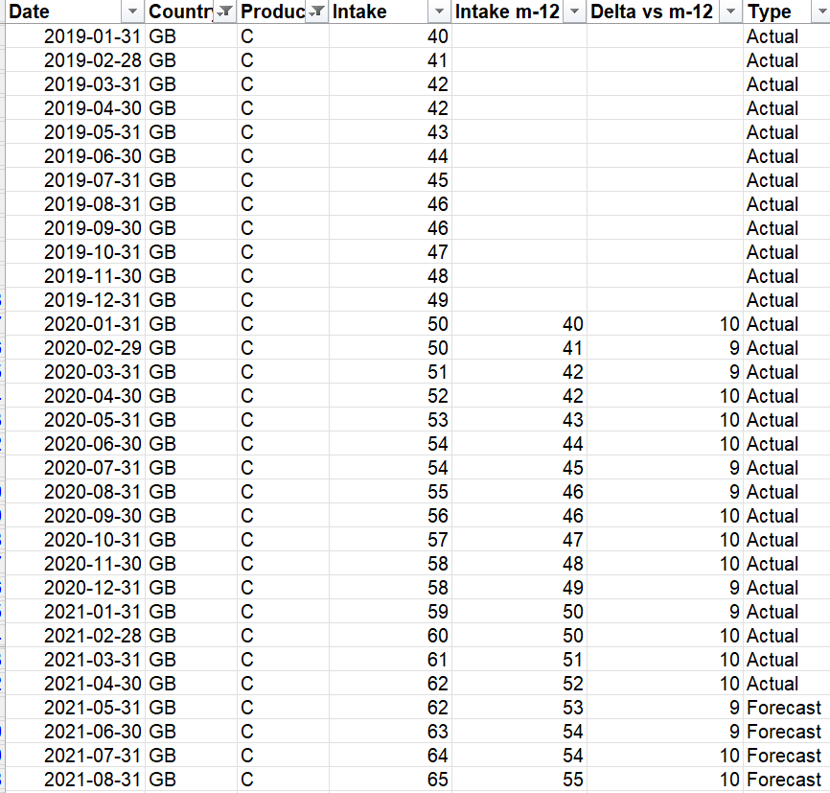
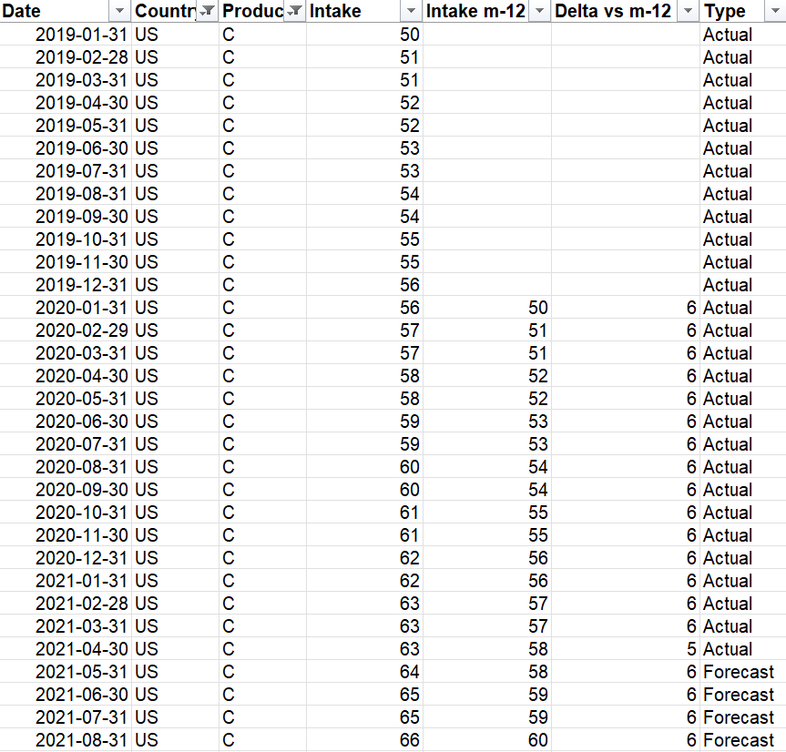
Exploring dataset 1 🔎
Product C: additive trend, no seasonality
=> Seems to be a slow growing product in each market (maybe because of market saturation), rather stable, maybe Spotify family?
Analysis and Forecast generation per country below*:
Even though the numbers were calculated in Excel, we could have fitted a Linear Regression model like Y_{month} = slope * Y_{month – 12} + b, and obtain slope = 1 and b = delta above for all of them
*main assumption: same pattern behavior in future as in past, more details in ‘submission_forecast_net_intake.xlsx’

Slide 9
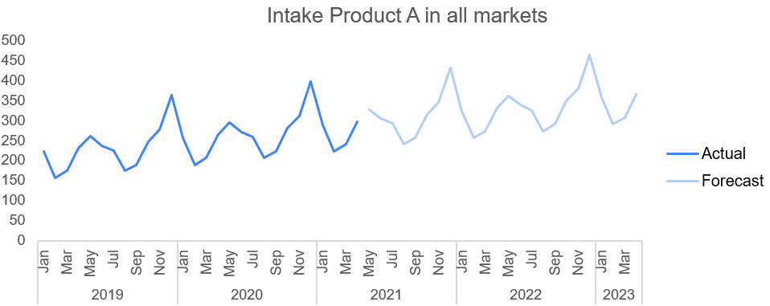
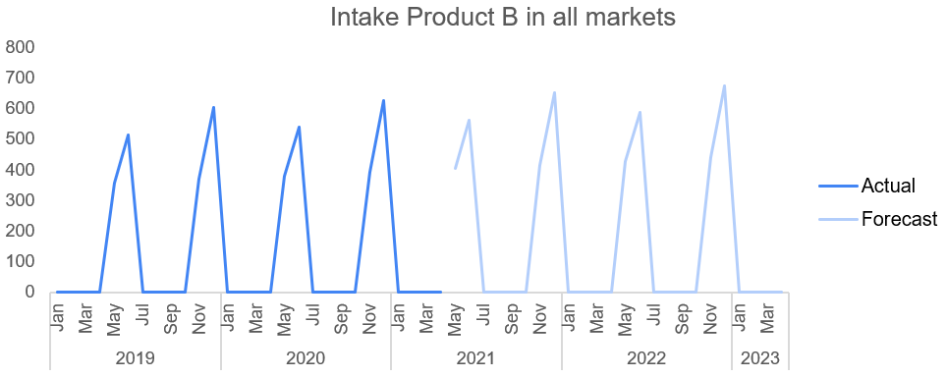
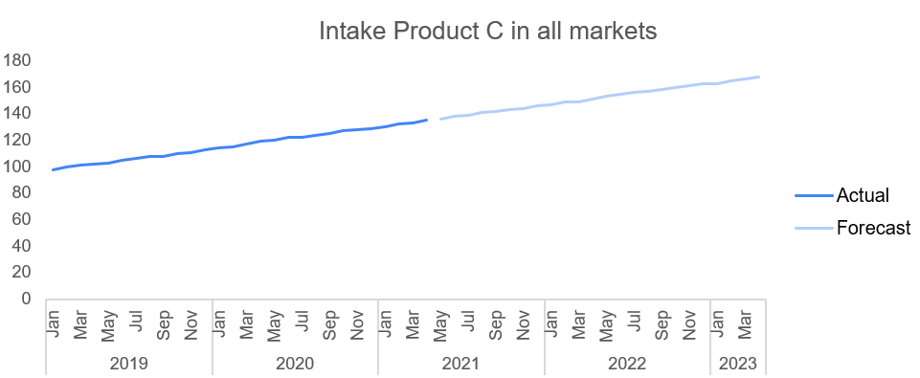
Forecast intake summary
The forecast extends historical patterns into the future, and it looks “reasonable”
More details in ‘submission_forecast_net_intake.xlsx’, forecast by Product x Country can be found in ‘saved_forecast_intake.csv’

Slide 10
Part 2: forecast net customers retained

Slide 11
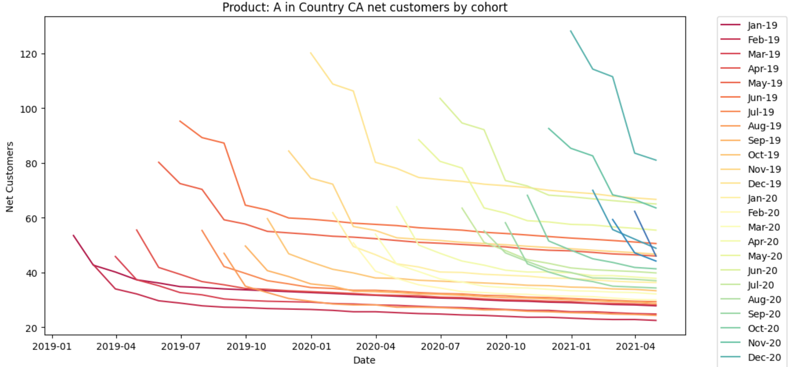
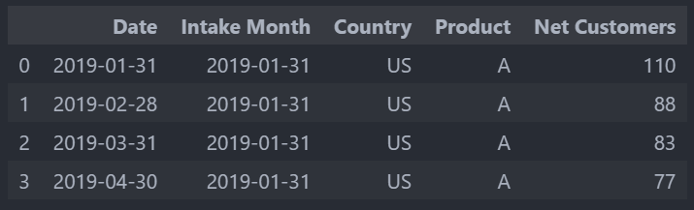
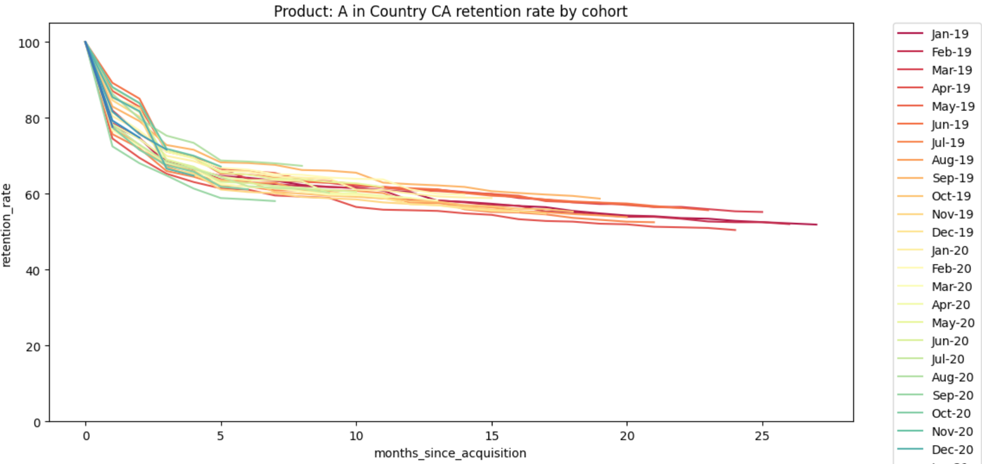
Forecast net customers: approach
Spoiler alert: instead of forecasting Net customers retained by calendar date, one could forecast the customer retention rate as a function of the cohort age.
Basically, go from this:
To this:
Retention rate cohort = Net Customers retained / initial Cohort size
Age Cohort = months elapsed since acquisition
For the 2 forecasting approaches that we will see (“baseline” and “ML”), the idea will be to forecast the decrease of retention rate at each month since the acquisition (the ‘diff’ or derivatives of the curve). From them, we will calculate the retention rates and ultimately the Net Customers.

Slide 12
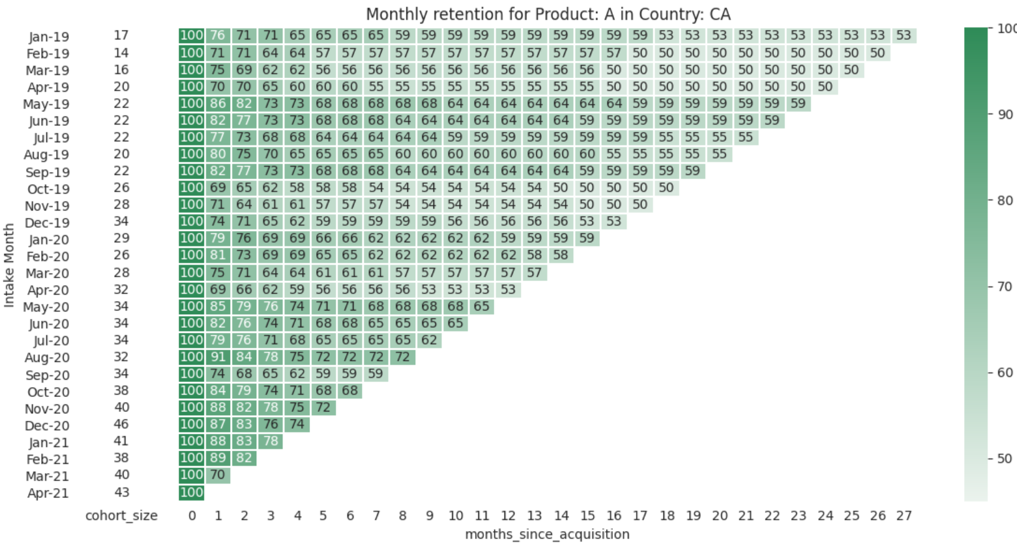
Before forecasting, let’s build some intuition 🤔
A good way to summarize how retention rates vary with the age of the cohort is to use a heatmap and try to detect some patterns

Slide 13
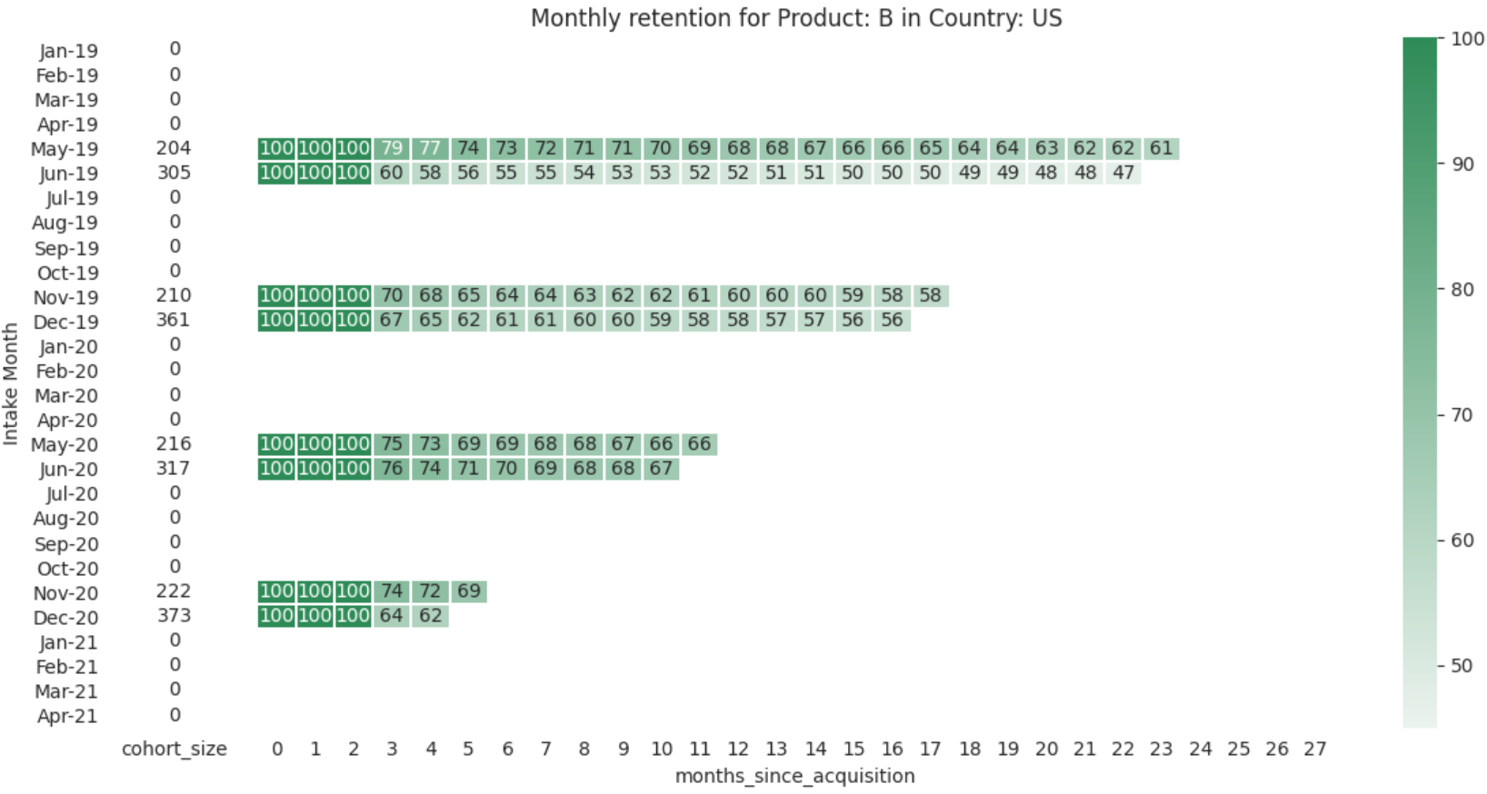
Before forecasting, let’s build some intuition 🤔
Insights: the retention rate depends: on the age of cohort (cf. the three 100’s) and on the Intake month (cf. all the blanks outside May-Jun-Nov,Dec)

Slide 14
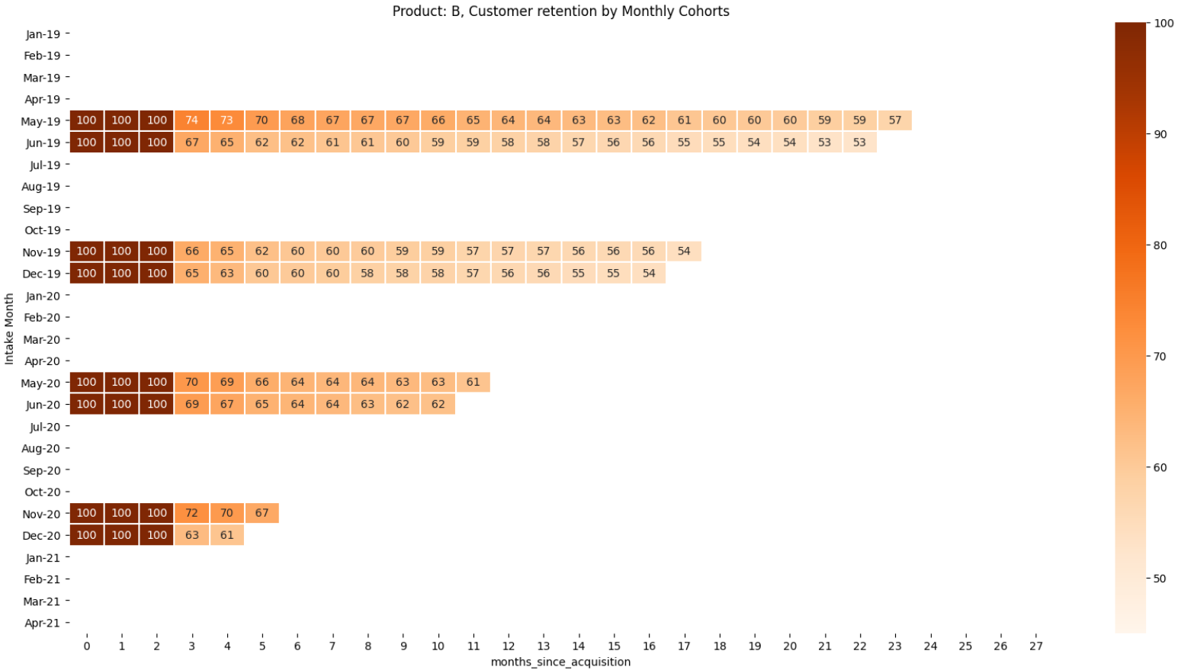
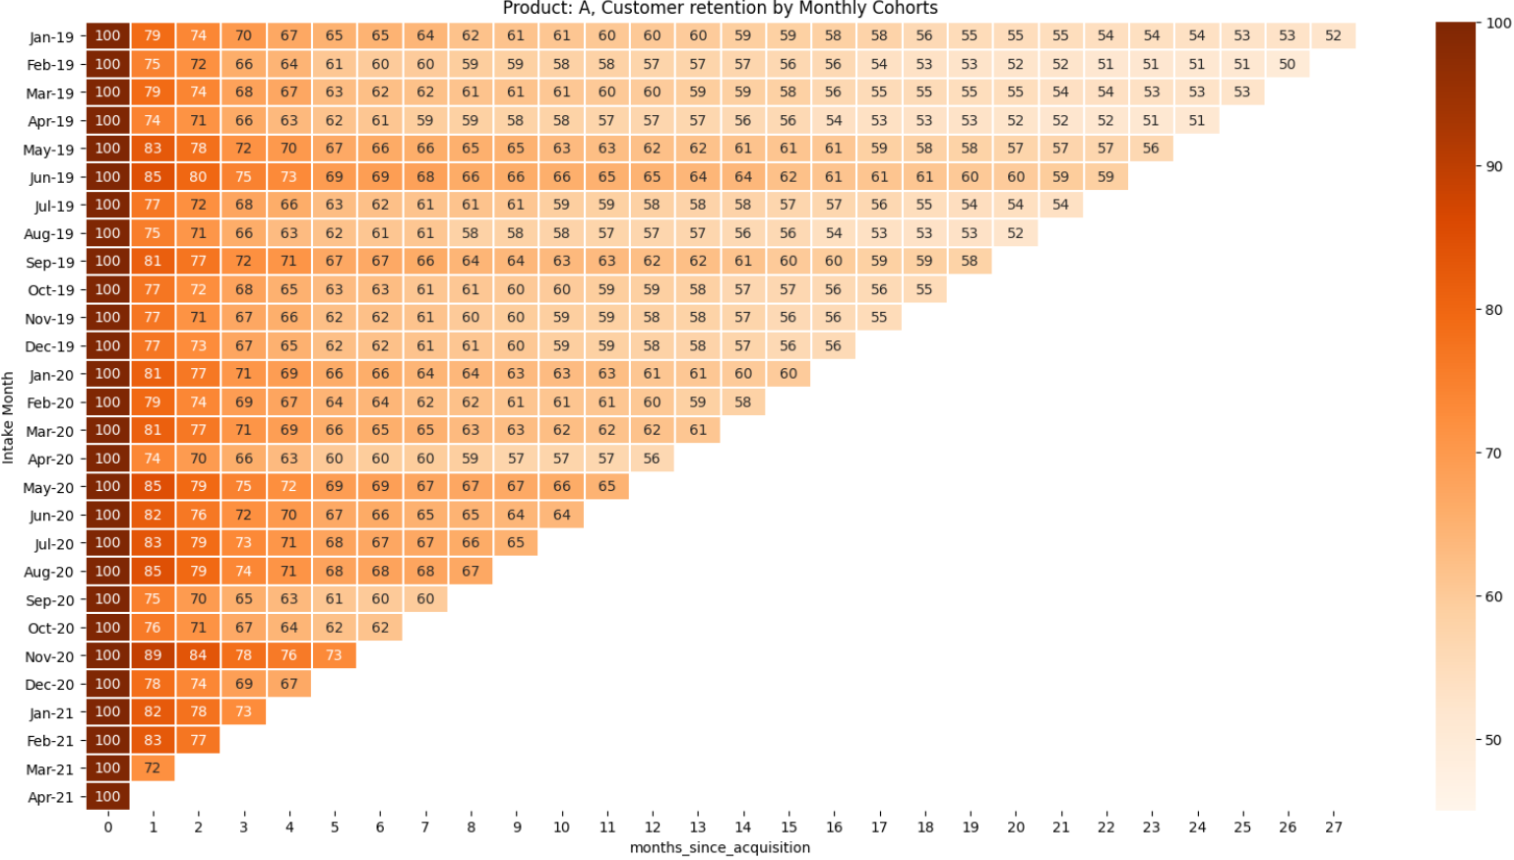
Before forecasting, let’s build some intuition 🤔
Insights: the retention rate depends both on the Product…

Slide 15
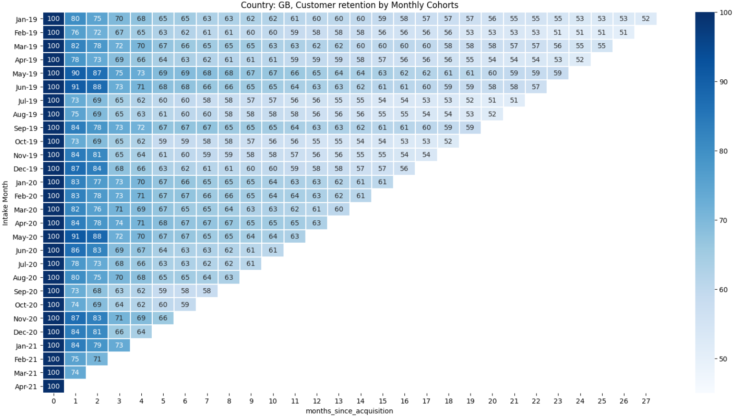
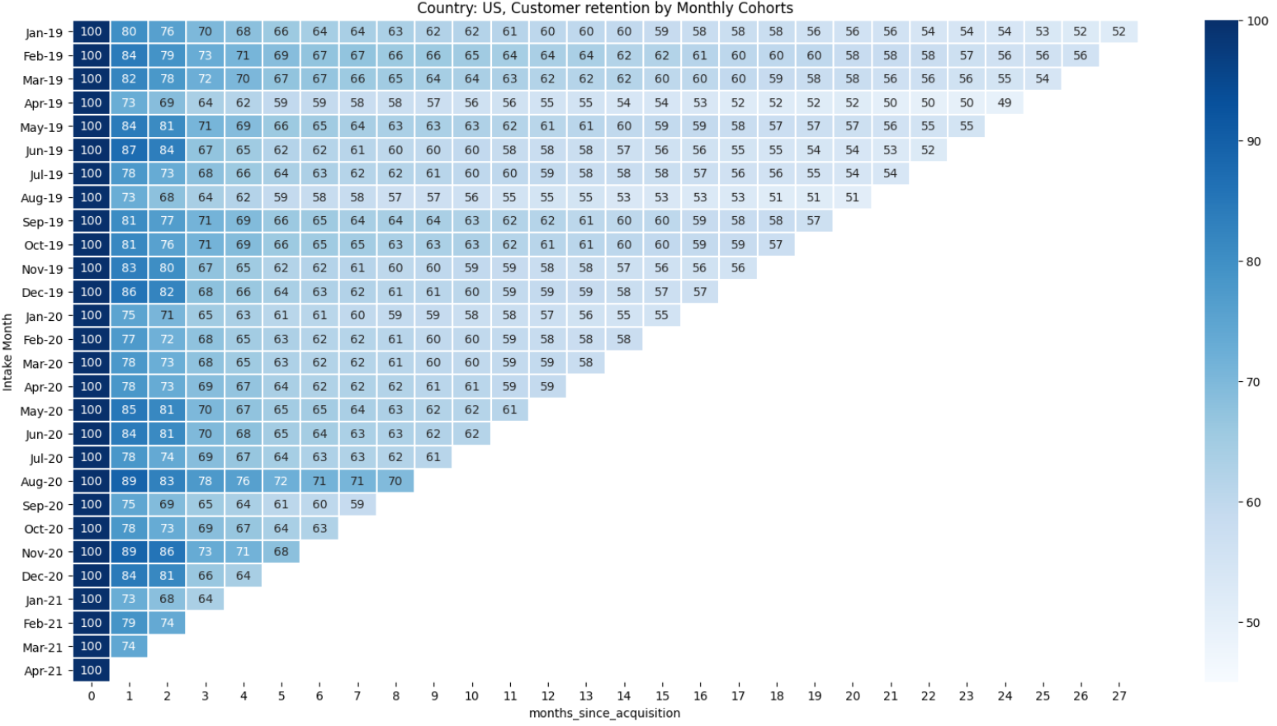
Before forecasting, let’s build some intuition 🤔
Insights: … and on the Country

Slide 16
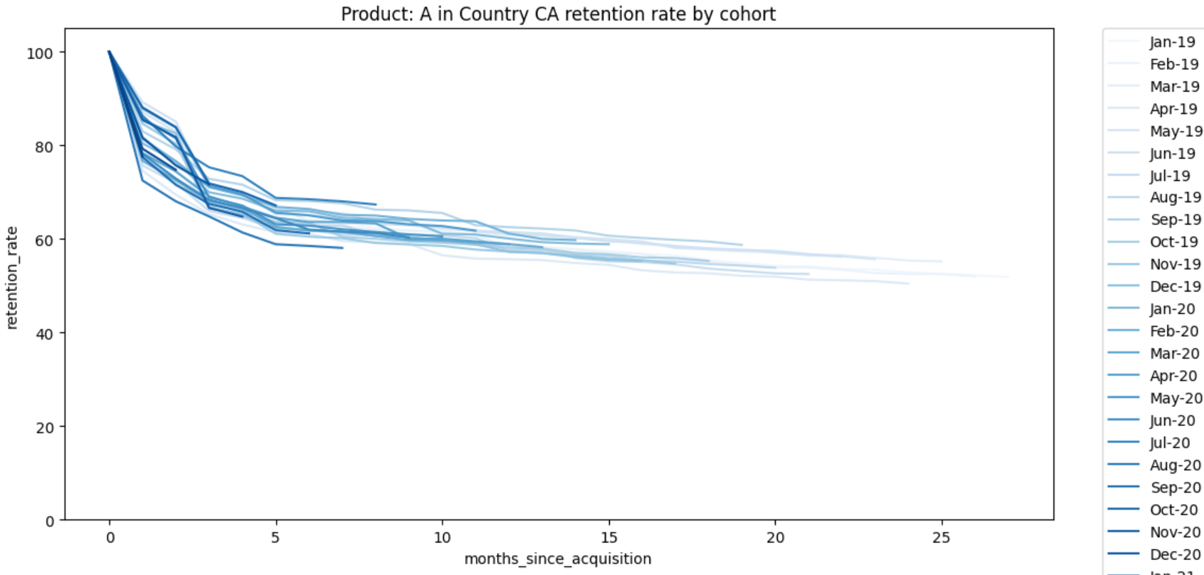
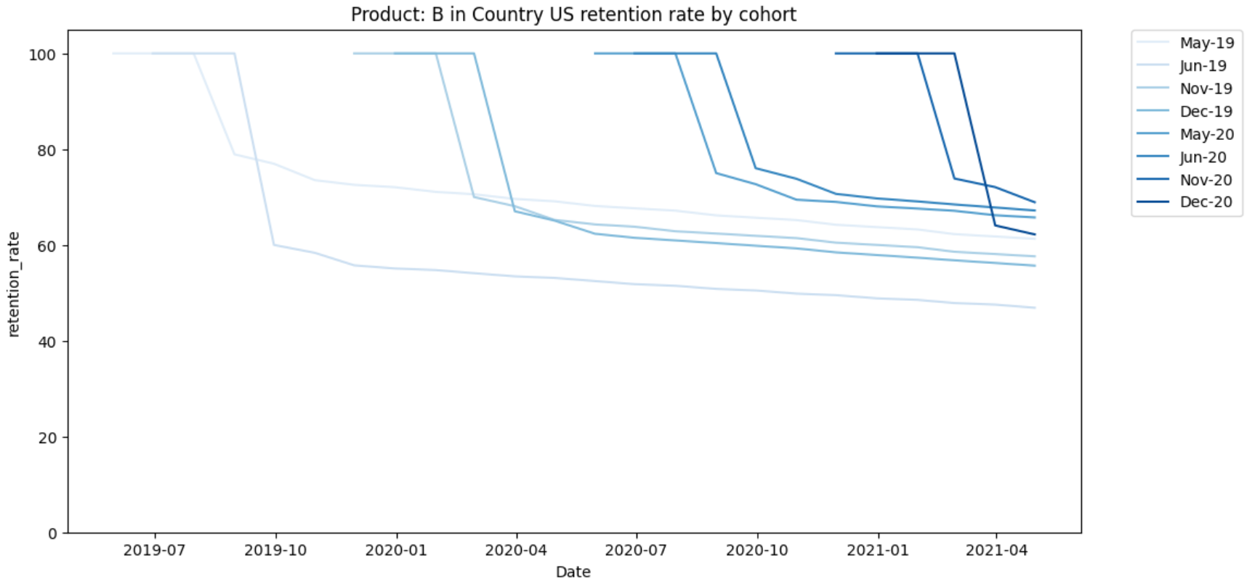
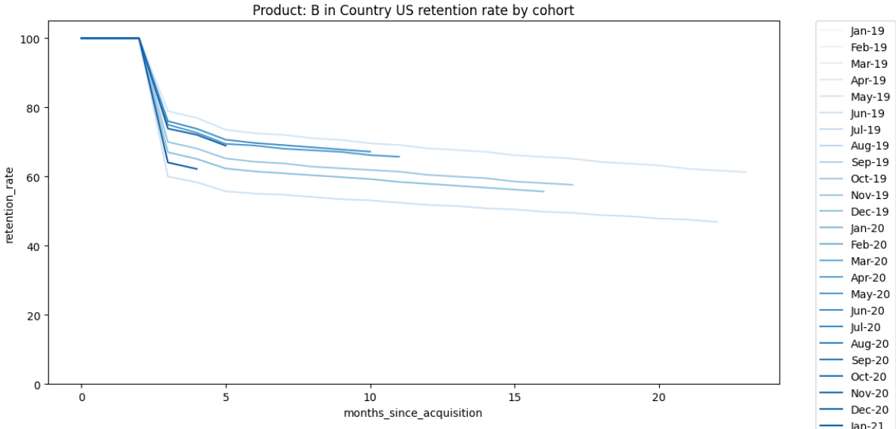
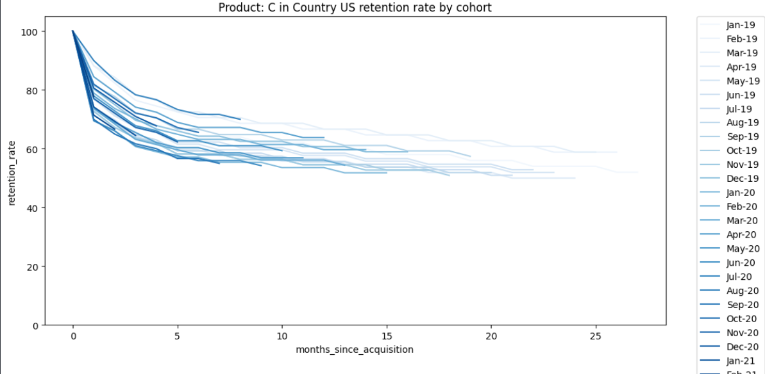
Before forecasting, let’s build some intuition 🤔
Insights:
the retention rate depends also on how close we are to today’s date
the retention rates seem to decrease with a rather stable rate (slope) after the first 6 months

Slide 17
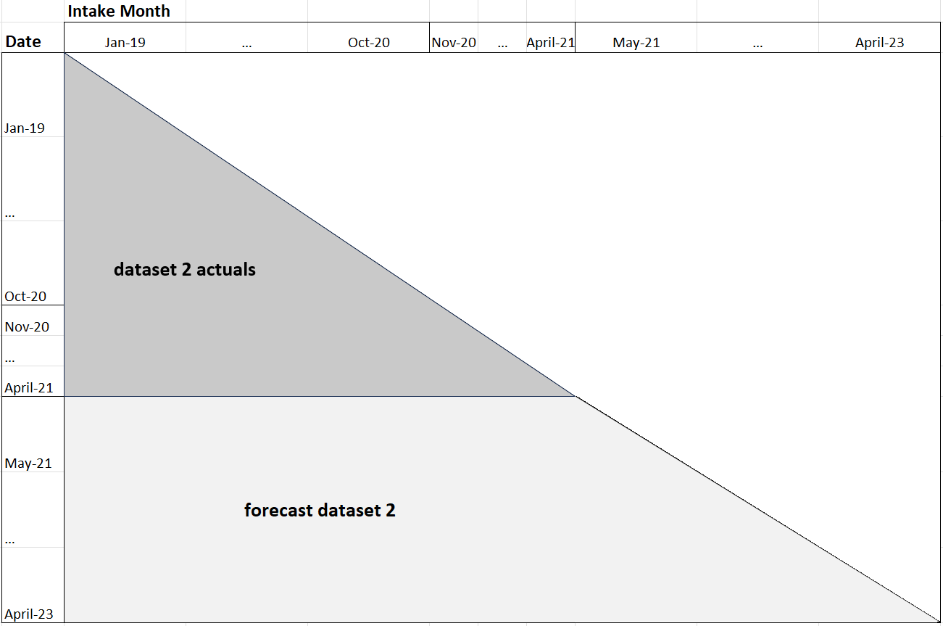
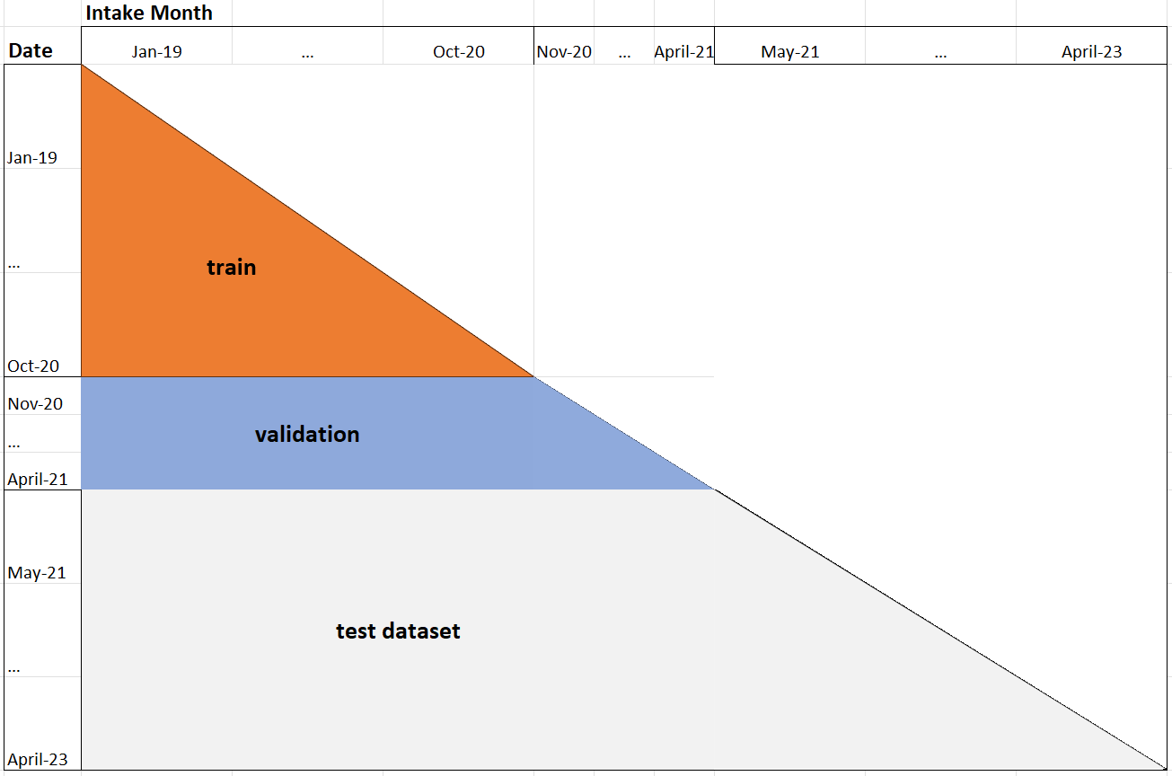
Armed with intuition, we can now forecast =)
Recap of insights: > retention rates = f (Product, Country, age Cohort, intake month, how recent the cohort is), their interaction and possibly many other external factors. > They decrease almost linearly after 6 months.
Recap of goal: forecast Net customers in the next 24 months
Split dataset 2 (“actuals”) into train and validation
Baseline approach: the dataset being small, with relatively clear patterns, we could use the historical rate of variation retention rates per Product x Country to forecast the future retention rates (Note: we will compare it to a more ML method later).
Proposed methodology:
a) Cross validation (to assess model performance): we divide Cohorts in 3 groups:
a.1) old (before April 2021), further divided into “train” and “validation” using “October 2020” as splitting date.
a.2) new (Intake Month after April 2021), the “test” dataset.

Slide 18
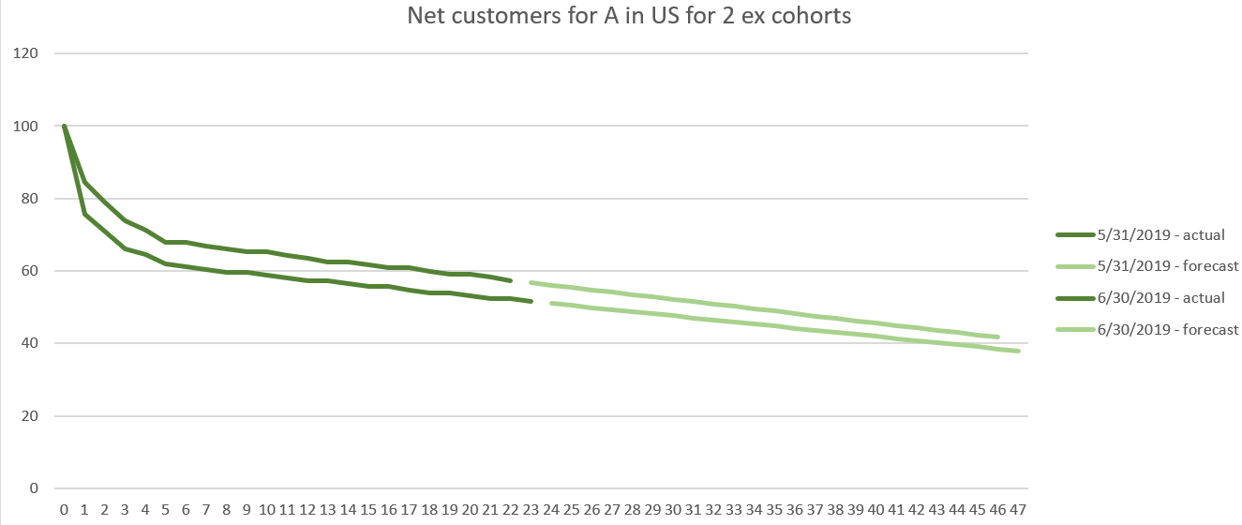
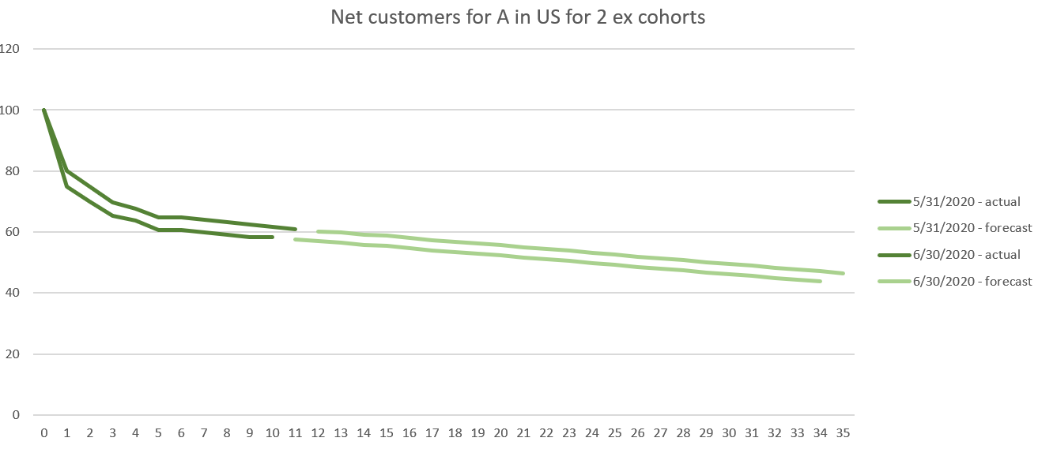
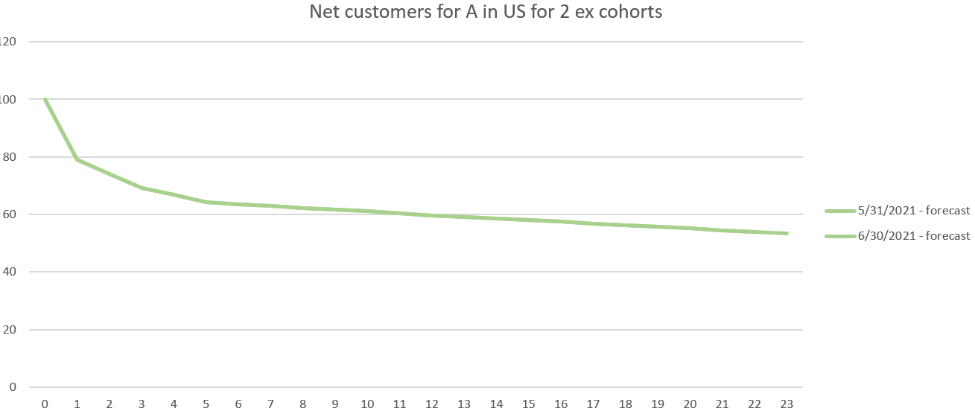
Baseline approach: methodology
b) Forecasting approach:
b.1 as a first step, we will construct a simple baseline method that calculates the rate of change of the retention rate at each month since acquisition for each Country x Product (think of them as the ‘derivatives’ of the retention rate at each step). => we obtain a kind of template (or curve) which describes the variation of the retention rate at each time step for each Country x Product
b.2 We use previous retrieved template to forecast retention rates in the future
b.3 From the forecasted retention rates, we retrieved the Net Customer by multiplying "forecasted retention rates" * "initial Cohort size"
b.1) Assuming that retention rate linearly decays after the first 6 months, we forecast the retention rates for train dataset.
b.2) We calculate the derivatives (diff) of the retention rate for each Product x Country x Cohort x age b.2) Calculate the average delta of retention rates per Product x Country x age Cohort (we obtain a “template” of curve per Product x Country with respect to the month since acquisition)
b.4) use the average change of retention rate per Product x Country x to forecast “valid” retention rates.
b.4) idem with “test”
in the script ‘2_a_forecast_case_modelling_baseline.ipynb’,

Slide 19
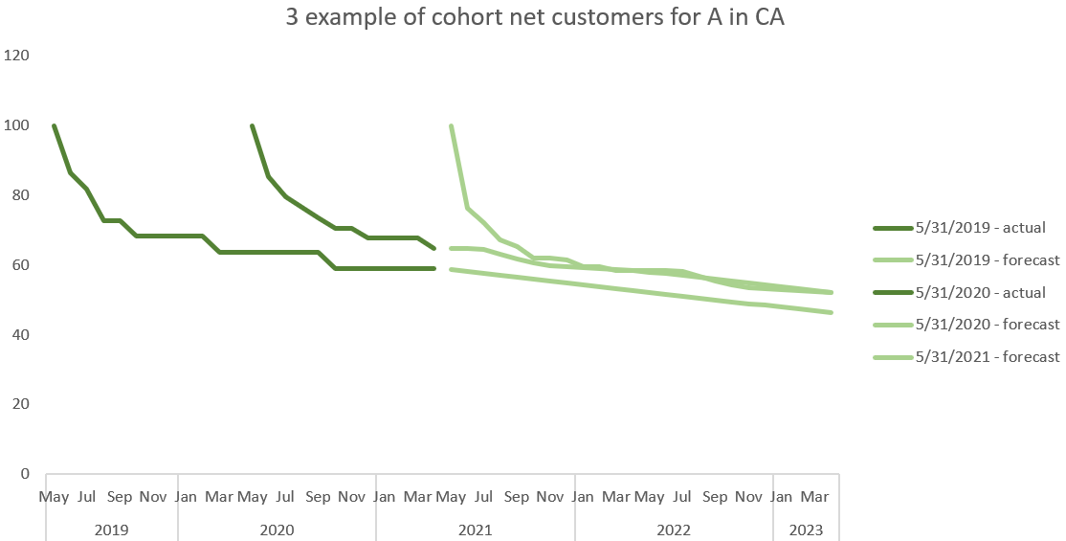
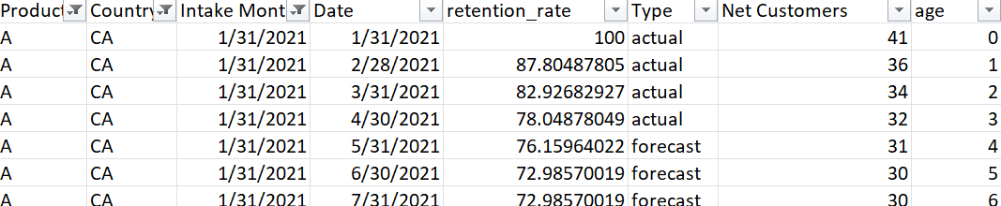
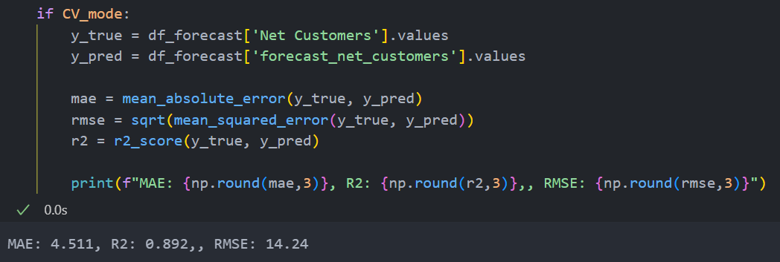
Baseline approach: results
Output: excel file ‘submission_forecast_net_customers_baseline’ with forecasted retention rates and Net customers per Cohort*
Expected performance: as calculated from the validation dataset with CV, the quality of fit of the baseline approach R² is 89% and the expected mean absolute error is 4.51 and Root Mean Squared Error 14.24.
=> the results are relatively good considering it is a very basic approach,
we will see if we can improve with ML
*Modelling script in ‘2_a_forecast_case_modelling_baseline.ipynb’.
To obtain expected performance, run the notebook with “CV_mode” = True (Cross validation mode).

Slide 20
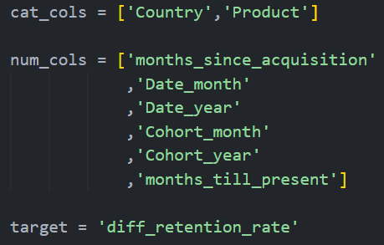
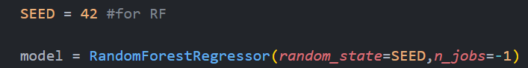
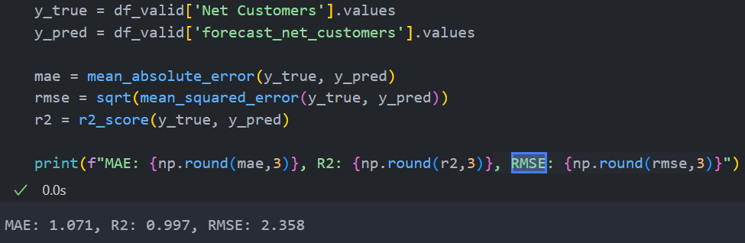
ML approach: results
New slide
Input: we will attempt to predict the change in retention rate given this input
Model: Random Forest Regressor with default parameters
Expected performance: as calculated from the validation dataset with CV, the quality of fit of the baseline approach R² is 99.7% and the expected mean absolute error is 1.07 and Root Mean Squared Error 2.36.
=> even taking these basic features,
the expected quality of the forecast is quite good
*Modelling script in ‘2_b_forecast_case_modelling_random_forest.ipynb’.

Slide 21
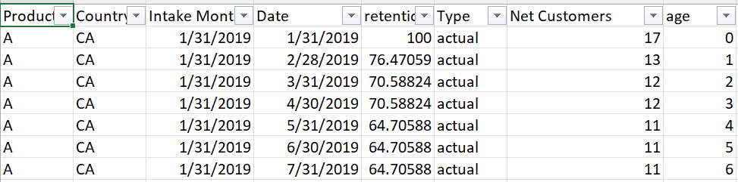


ML approach: results
New slide
Output: excel file ‘submission_forecast_net_customers_random_forest’ with forecasted retention rates and Net customers per Cohort*
Variable importance: we can get a ranking on the importance of each “feature” for the model.
=> age (months since acquisition” and Product seem to be the most important information to predict future next customers.
=> in a way also confirms why the baseline approach worked relatively well
*Modelling script in ‘2_b_forecast_case_modelling_random_forest.ipynb’.

Slide 22
Conclusions and other paths of analysis
Quick comment about the 2 approaches:
(+)
=> forecasting retention rates (and its rates of variation) rather than the Net Customers directly seems a simple yet robust approach.
=> both approaches confirmed our initial intuition from the explorative data analysis (see “building intuition” slides before).
=> the retention rates seem to depend more heavily in the Product and the age of the cohort than in the rest of the variables
=> good execution performance for both (run time less than half a minute for both methods)
(-)
=> the dataset and patterns are relatively simple. If we had more complex patterns in the retention rates (seasonality for ex, or 2 or 3 order interactions between the variables), we would need to more complex models (ARIMA, tree-based, survival analysis, polynomial regression, etc.) with some extra features like the lags of the retention rate in the model/

Slide 23


Conclusions and other paths of analysis
Forecasting the Net Customers opens the door to several other interesting analysis.
a) Business/Financial implications: estimate the MAU evolution per quarter and per Product x Country x Cohort.
which can be useful to estimate the total future revenue, the customer lifetime value, or evaluate the efforts of different marketing campaigns. In the other way around, one could also set the MAU targets for the future from the revenue targets and work out the acquisition levels for each month.

Slide 24
Conclusions and other paths of analysis
Forecasting the Net Customers opens the door to several other interesting analysis.
b) Product strategy:
b.1) Improve retention strategy: identifying long-term retention patterns for each cohort, one could test various retention strategies over time. For ex: to evaluate the onboarding processes, analyze how retained users interact with the onboarding experiences, and compare it with the interactions of the churned customers.
b.2) User behavior: Tracking product usage of retained users over time enables teams to identify successful user behaviors
b.3) Prevent churn: cohort analysis helps teams spot drop-off points in the user journey as well as churn warning signals.
b.4) R&D: cohort retention analysis combined with feature usage analytics and surveys, can be used to assess the impact of new features on user retention.
b.5) Brand loyalty: by understanding user retention, we can infer the stickiness/loyalty of the customers and evaluate the health of the business.

Slide 25
Questions?

Slide 26
Thank you!

Slide 27



Appendix: files

